Slide 1

Computer Organization and Assembly Language
Dr. Rabia Tabassum

Slide 2
Chapter -2 Topics
2.1 General Concepts
Basic Microcomputer Design
Instruction Execution cycle
Reading from Memory
How Program Run
2.2 x86 Architecture Details
Mode of Operation (including detail from 2.3)
Basic Execution Environment ( All types of Registers)
Floating-Point Unit

Slide 3
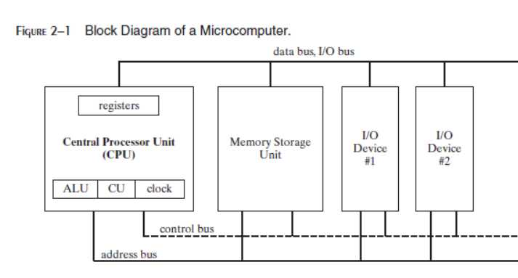
Basic Microcomputer Design
Assembly language is a great tool for learning how a computer works, and it requires you to have a working knowledge of computer hardware.

Slide 4
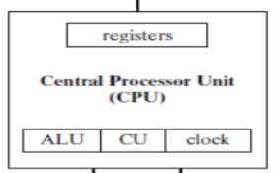
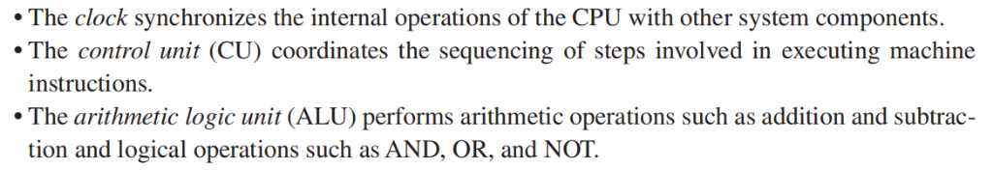
Basic Microcomputer Design
The central processor unit (CPU):
Where calculations and logic operations are performed:
• contains a limited number of storage locations
named Registers,
• a high-frequency Clock,
• a Control Unit, and
• an Arithmetic Logic Unit

Slide 5
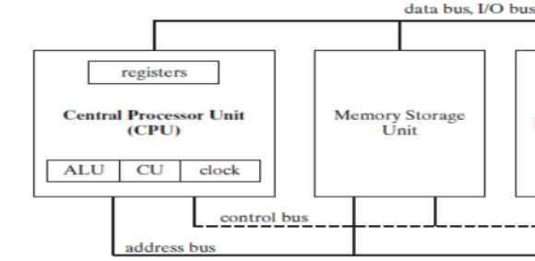
Basic Microcomputer Design
Memory storage unit
The memory storage unit is where instructions and data are held while a computer program is running.
The storage unit receives requests for data from the CPU, transfers data from random access memory (RAM) to the CPU, and transfers data from the CPU into memory.
All processing of data takes place within the CPU, so programs residing in memory must be copied into the CPU before they can execute.

Slide 6

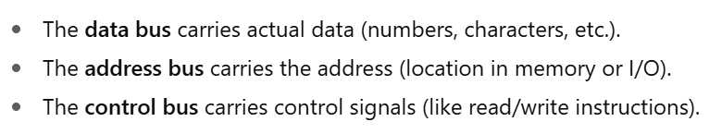
BUSES
A bus is a group of parallel wires that transfer data from one part of the computer to another. These buses are the eyes, nose, and ears of the processor.

Slide 7
BUSES
A computer system usually contains four bus types:
Data, I/O, Control, and Address.
The data bus transfers instructions and data between the CPU and memory.
It is bidirectional.
For Read operation : move – Memory to Processor
For Write operation : move –Processor to Memory
The address bus holds the addresses of instructions and data when the
currently executing instruction transfers data between the CPU and memory.
It is unidirectional and address always travel from processor to memory.

Slide 8
BUSES
The control bus uses binary signals to synchronize actions of all devices
attached to the system bus.
It is special and relatively complex , because different lines comprising it behave differently.
The I/O bus transfers data between the CPU and the system input/output devices.

Slide 9
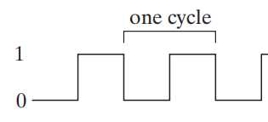
Clock and Clock Cycles
Clock synchronizes all CPU and BUS operations.
– Clock is used to trigger events
– Clock cycles( Machine cycles) measure time of a single operation
A machine instruction requires at least one clock cycle to execute.
Few instructions require in excess of 50 clocks (the multiply instruction on the 8088 processor, for example)
The duration of a clock cycle is the reciprocal of the clock’s speed.
For 1GHz frequency --- a clock cycle of 1 nanosecond.
Instructions requiring memory access often have empty clock cycles called wait states, because of the differences in the speeds of the CPU, the system bus, and memory circuits.

Slide 10
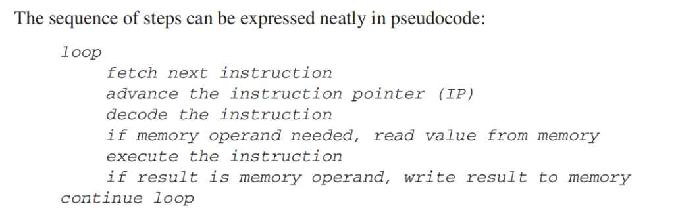
Instruction Execution Cycle
The CPU go through a predefined sequence of steps to execute a machine instruction, called the instruction execution cycle.
The execution of a single machine instruction can be divided into a sequence of individual operations.
The primary operations : Fetch , Decode , and Execute.
Two more steps are required when the instruction uses a memory operand: Fetch Operand and Store output Operand.
PC: Program Control Register
Fetch
Decode
Fetch Operand
Execute
Store Output

Slide 11
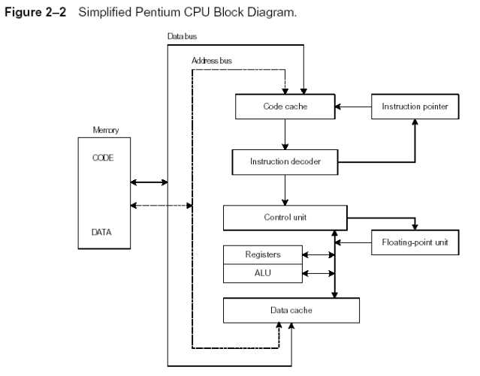
Instruction Execution Cycle

Slide 12
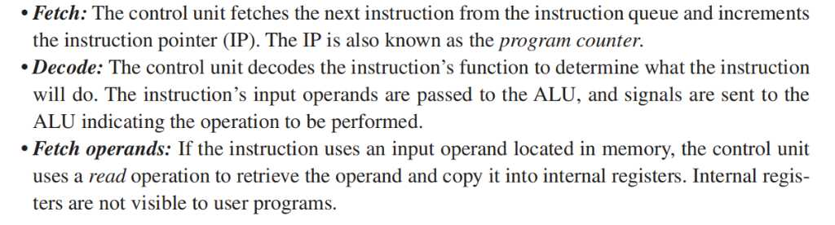
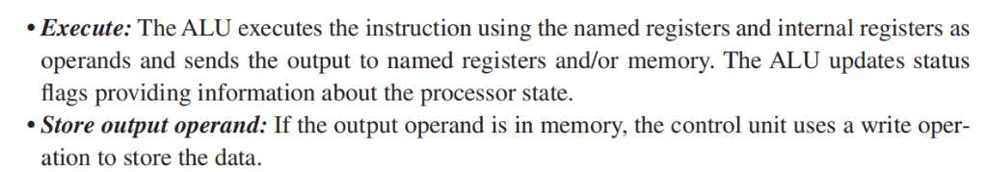
Instruction Execution Cycle

Slide 13
Instruction Execution Cycle
An operand is a value that is either an input or an output to an operation
For example, the expression Z = X + Y has two input operands
(X and Y) and a single output operand (Z)
In order to read program instructions from memory, an address is placed on the address bus .
The memory controller places the requested code on the data bus making the code available inside the code cache.
The instruction pointer’s value determines which instruction will be executed next.
The instruction is analyzed by the instruction decoder, causing the appropriate digital signals to be sent to the control unit, which coordinates the ALU and floating-point unit.
Although the control bus is not shown in this figure, it carries signals that use the system clock to coordinate the transfer of data between the different CPU components.

Slide 14
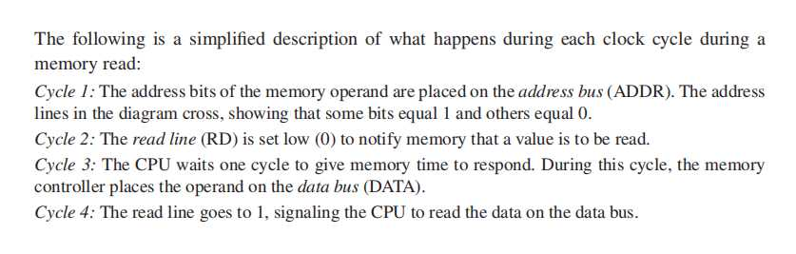
Reading from Memory
As a rule, computers read memory much more slowly than they access internal registers.
Reading a single value from memory involves four separate steps:
1. Place the address of the value you want to read on the address bus.
2. Assert (change the value of) the processor’s RD (read) pin.
3. Wait few clock cycle for the memory chips to respond.
4. Copy the data from the data bus into the destination operand.
Each of these steps generally requires a single clock cycle,

Slide 15
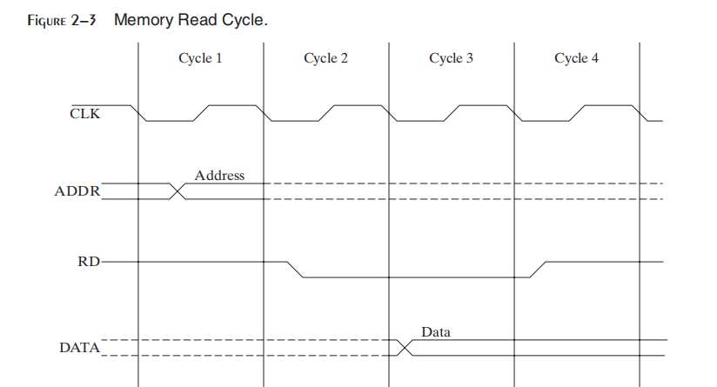
Reading from Memory

Slide 16
Cache
CPU designers figured out that computer memory creates a speed bottleneck – because most programs have to access variables
To reduce the amount of time spent in reading and writing memory
– the most recently used instructions and data are stored in high- speed memory called Cache
The idea is that a program is more likely want to access the same memory and instructions repeatedly – so cache keeps these values where they can be accessed quickly

Slide 17
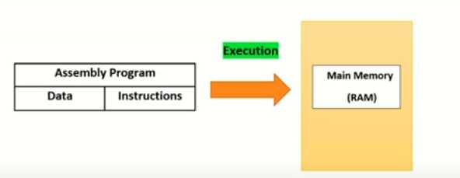
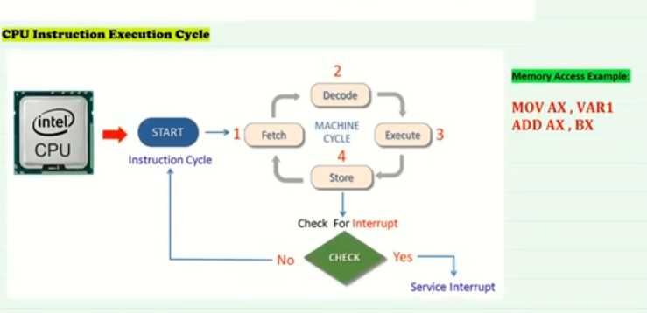

Slide 18
Cache
When the CPU begins to execute a program, it loads the next thousand instructions (for example) into cache
– The assumption is that these instructions will be needed in the
near future.
• If it happens to be a loop in that block of code, the same instructions will be in cache
• When the processor is able to find its data in cache memory, we call that a Cache Hit
• On the other hand, if the CPU tries to find something in cache and it’s not there, we call that a Cache Miss

Slide 19
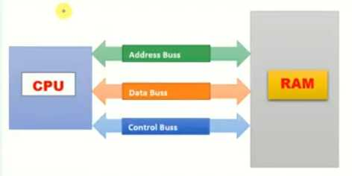
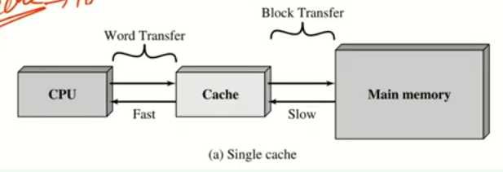

Slide 20
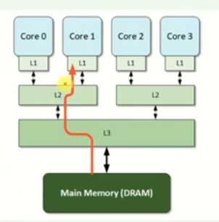
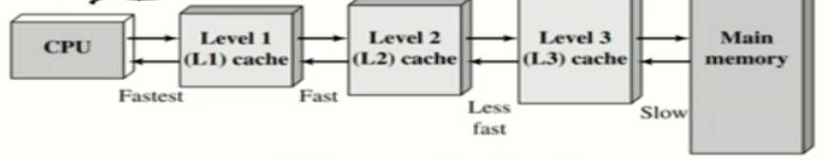
x86 family Cache types
Cache memory for the x86 family comes in three types.
– Level-1 cache (or primary cache) is stored right on the CPU.
– Level-2 cache (or secondary cache) is a little bit slower, and attached to the CPU
-Level-3 cache (or secondary cache) is a more slower, and attached to the CPU

Slide 21
Why cache memory is faster than conventional RAM?
It’s because cache memory is constructed from a special type of memory chip called static RAM
- It’s expensive, but it does not have to be constantly refreshed in order to keep its contents
Conventional memory, known as dynamic RAM, refreshed constantly
– It’s much slower, and cheaper

Slide 22
Loading and Executing a Program
The operating system (OS) searches for the program’s filename in the current disk directory
– If it cannot find the name there, it searches a predetermined list of directories (called paths) for the filename
– If the OS fails to find the program filename, it issues an error message.
If the program file is found, the OS retrieves basic information about the program’s file from the disk directory
– including the file size and
– its physical location on the disk drive.

Slide 23
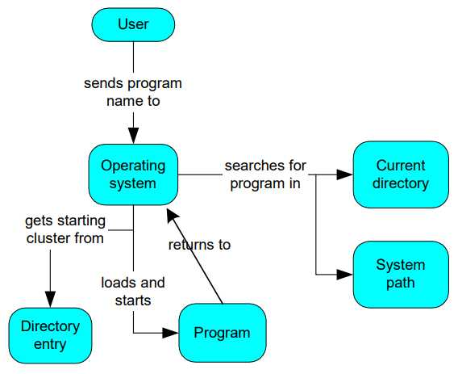
Loading and Executing a Program

Slide 24
Loading and Executing a Program
• The OS determines the next available location in memory and loads the program file into memory
– It allocates a block of memory to the program and enters information about the program’s size and location into a table (sometimes called a descriptor table).
– The OS also adjust the values of pointers within the program so they contain addresses of program data.
The OS begins execution of the program’s first machine instruction (its entry point).

Slide 25
Loading and Executing a Program
• As soon as the program begins running, it is called a process.
• The OS assigns the process an identification number (process ID),
which is used to keep track of it while running.
• It is the OS’s job to track the execution of the process and to respond to requests for system resources.
– Examples of resources are memory, disk files, and input-output devices.
• When the process ends, it is removed from memory.

Slide 26
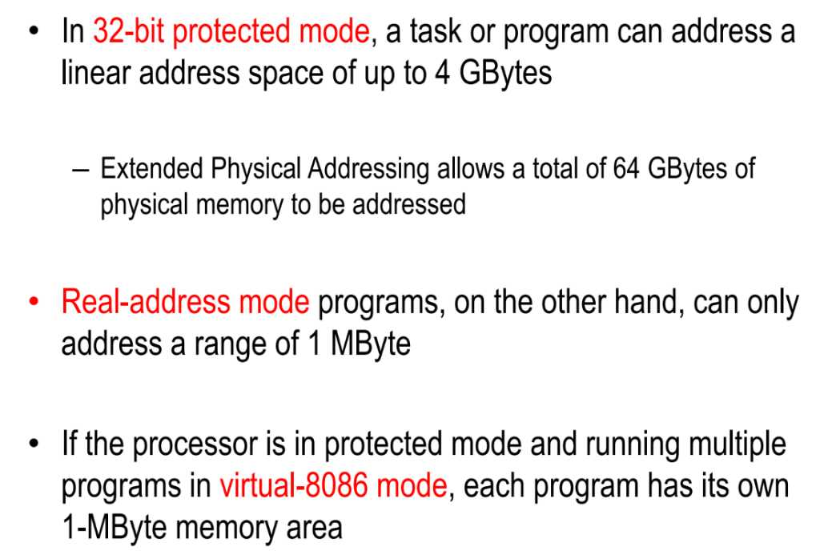
Basic Execution Environment
Address Space

Slide 27
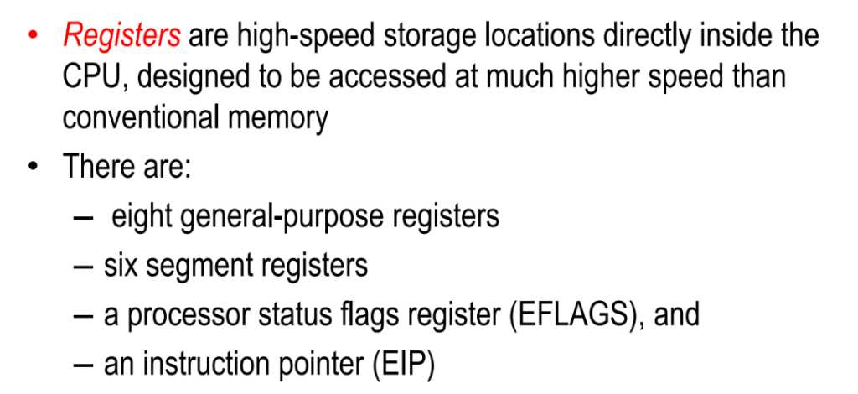
Basic Program Execution Registers

Slide 28
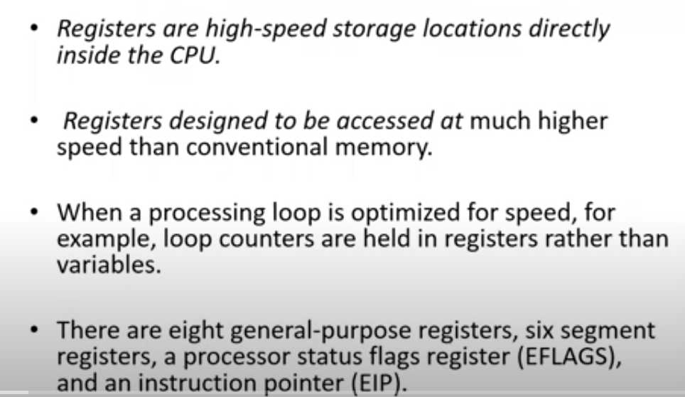
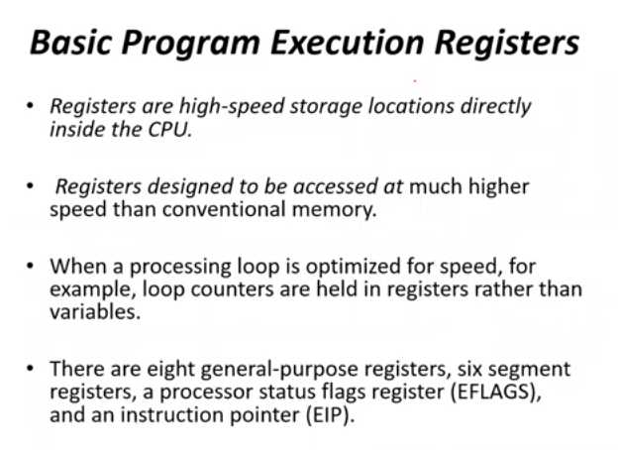

Slide 29
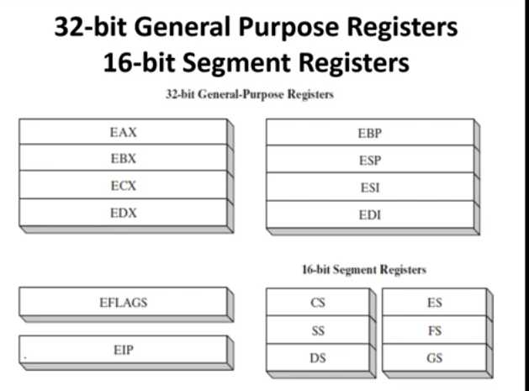

Slide 30
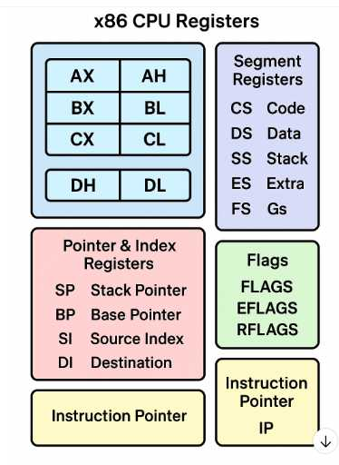

Slide 31
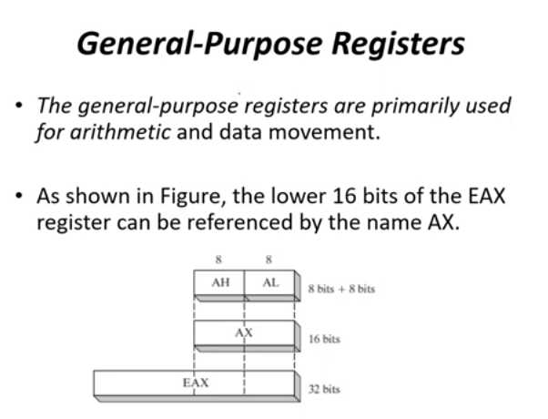

Slide 32
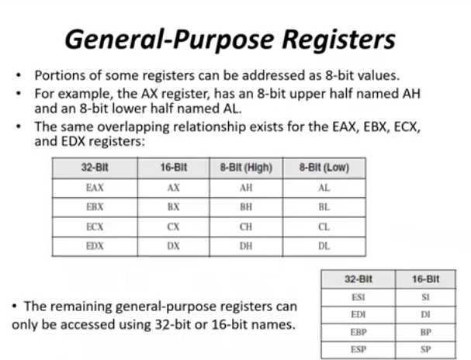

Slide 33
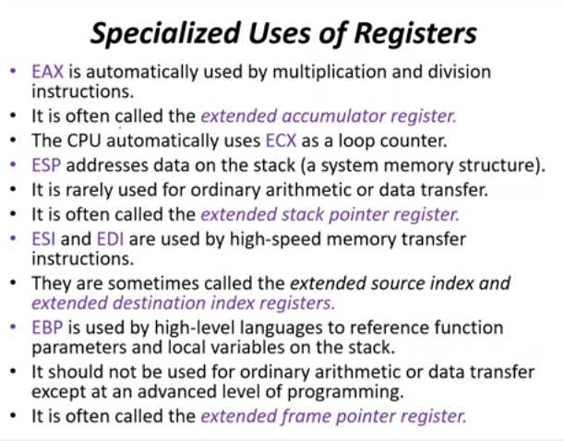

Slide 34
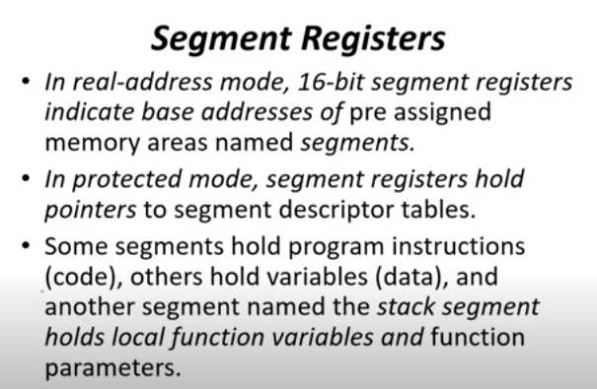

Slide 35
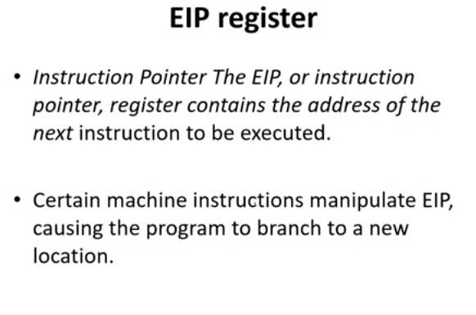

Slide 36
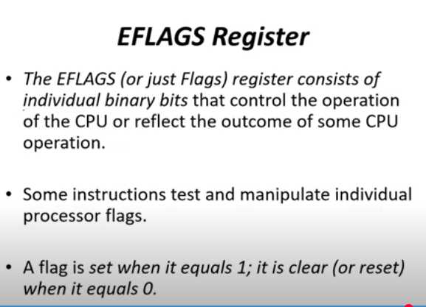

Slide 37
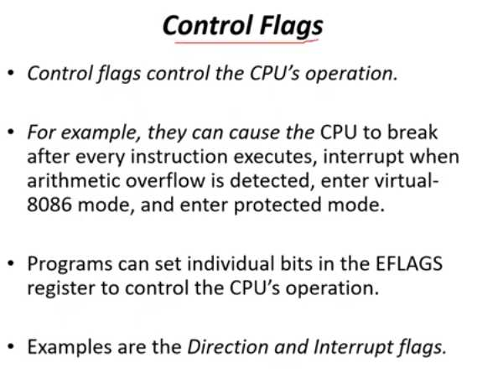

Slide 38
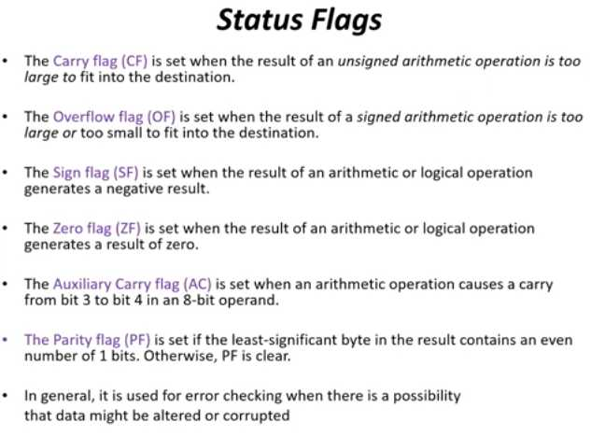

Slide 39
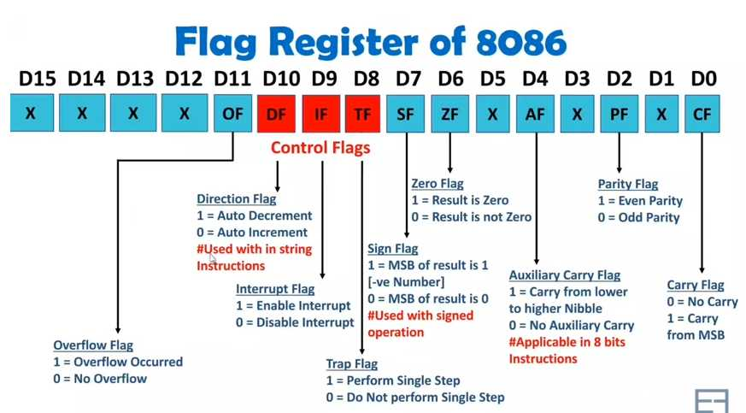

Slide 40
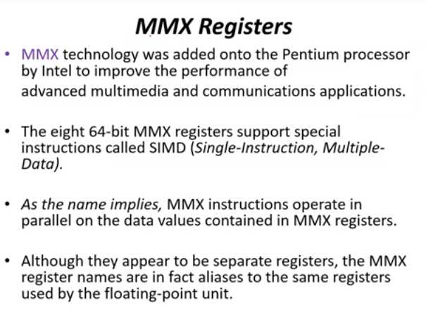

Slide 41
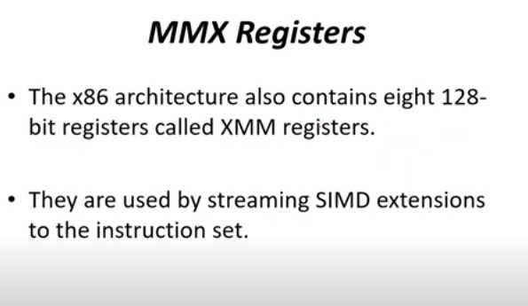

Slide 42
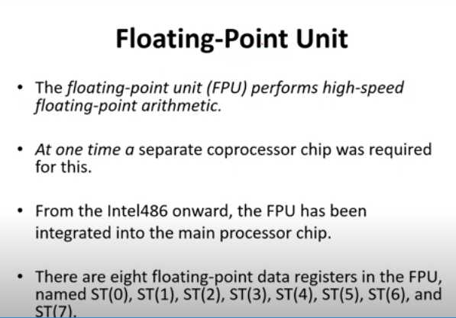

Slide 43
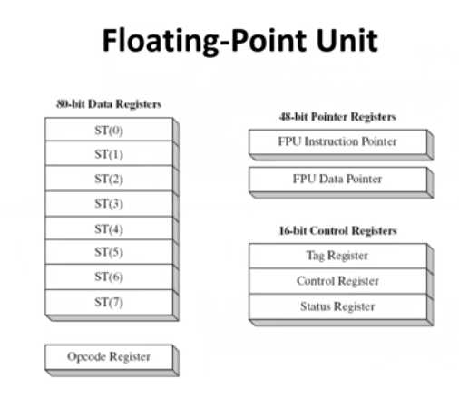

Slide 44
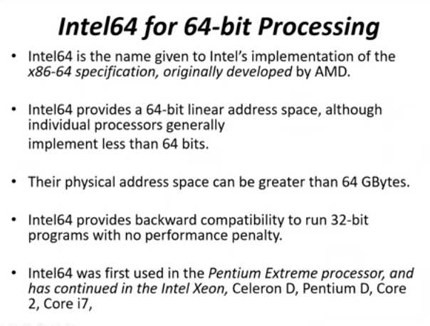

Slide 45
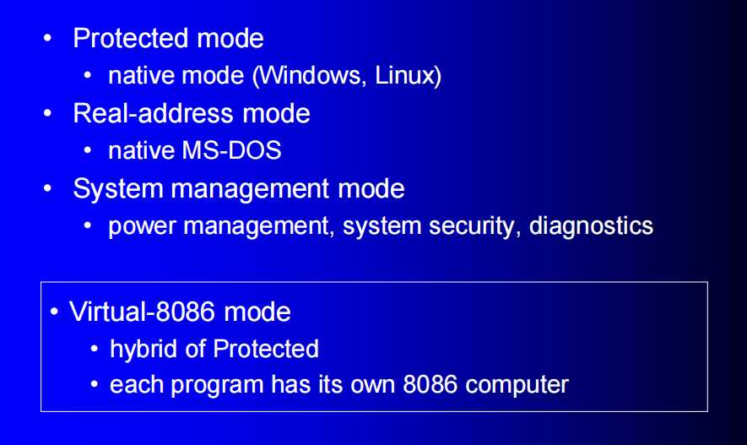
Mode of Operations

Slide 46
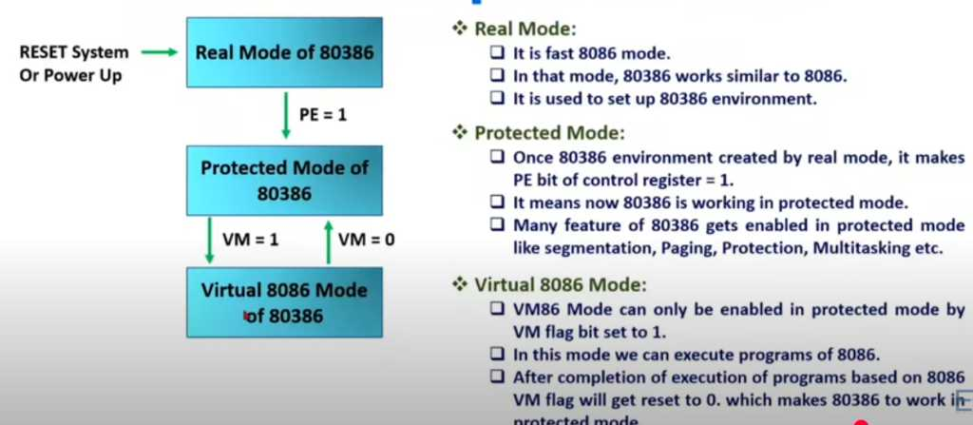

Slide 47
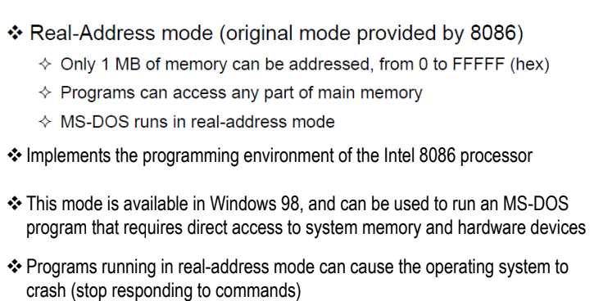
Mode of Operations

Slide 48
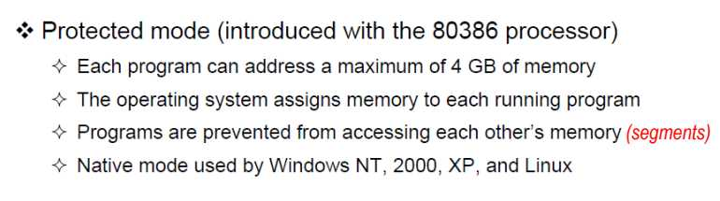
Mode of Operations

Slide 49
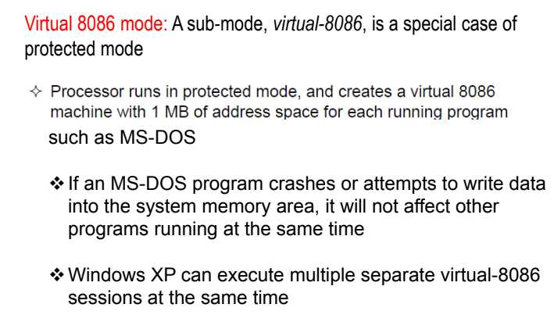
Mode of Operations

Slide 50
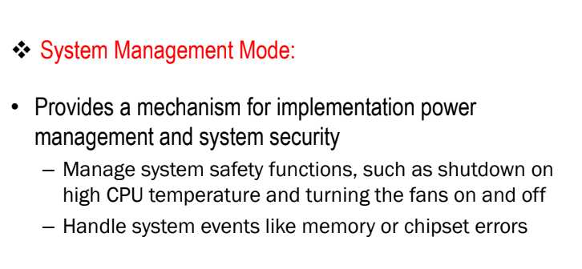
Mode of Operations

Slide 51
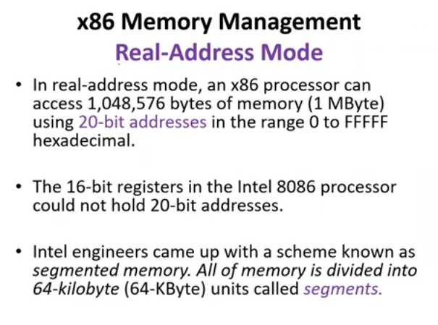

Slide 52
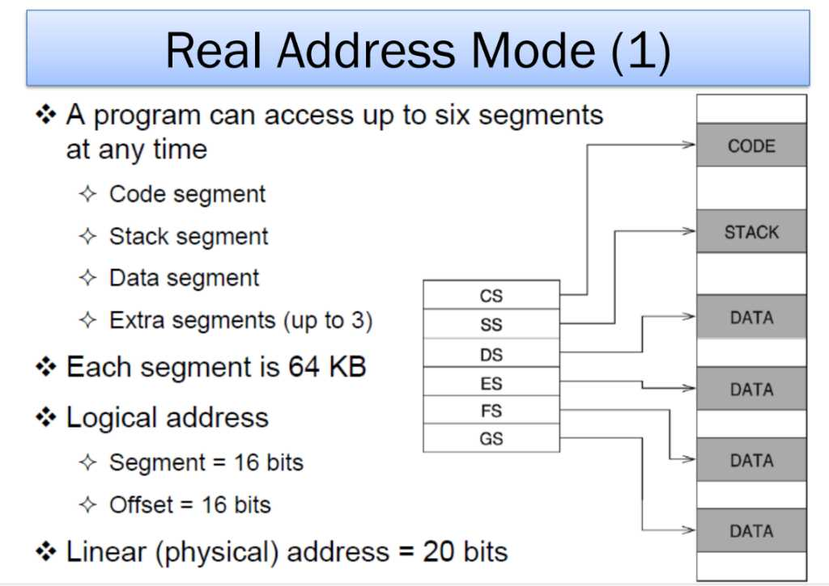

Slide 53
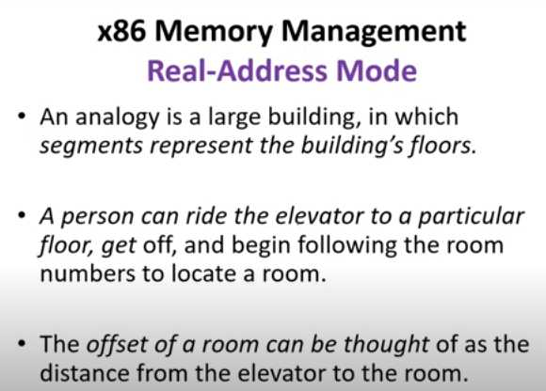

Slide 54

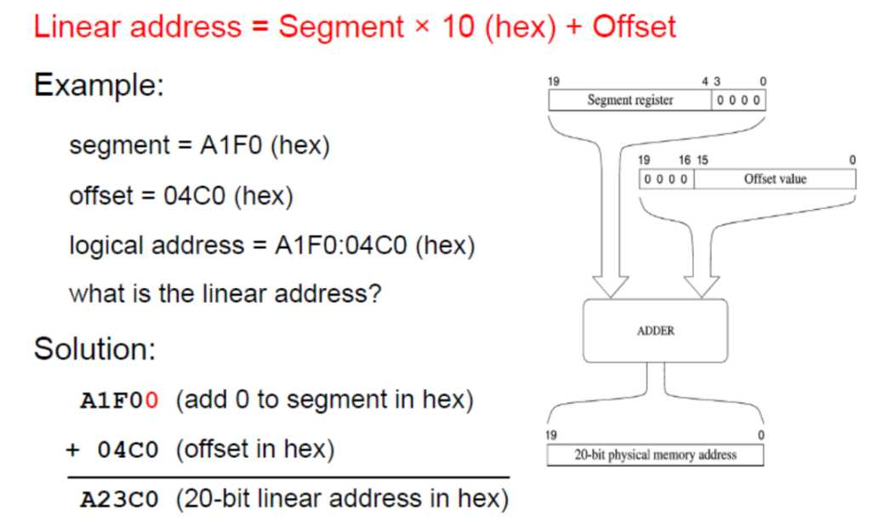

Slide 55
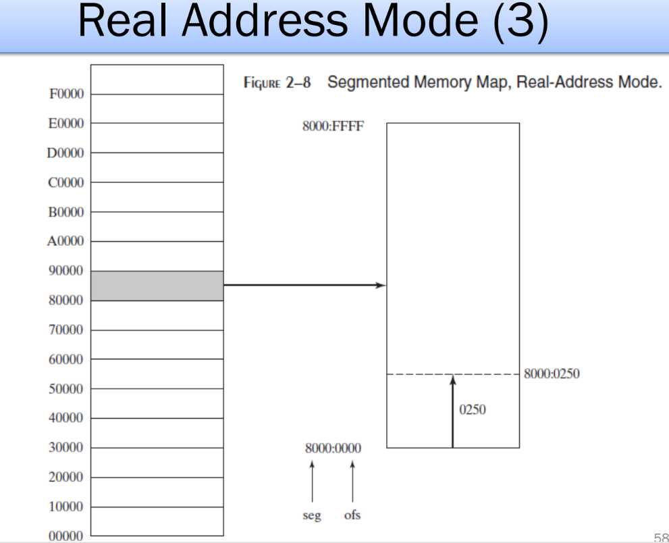

Slide 56


Slide 57


Slide 58


Slide 59


Slide 60


Slide 61


Slide 62


Slide 63


Slide 64


Slide 65


Slide 66


Slide 67


